Slide 1
Uva 1213 LA 3619
Sum of Different Primes
Time: 3 seconds

Slide 2
Problem Descriptions (1/3)
A positive integer may be expressed as a sum of different prime numbers (primes), in one way or another.
Given two positive integers n and k, you should count the number of ways to express n as a sum of k different primes.
Here, two ways are considered to be the same if they sum up the same set of the primes. For example, 8 can be expressed as 3 + 5 and 5 + 3 but they are not distinguished.

Slide 3
Problem Descriptions (2/3)
When n and k are 24 and 3 respectively, the answer is two because there are two sets {2, 3, 19} and {2, 5, 17} whose sums are equal to 24. There are no other sets of three primes that sum up to 24.
For n = 24 and k = 2, the answer is three, because there are three sets {5, 19}, {7, 17} and {11, 13}.
For n = 2 and k = 1, the answer is one, because there is only one set {2} whose sum is 2.

Slide 4
Problem Descriptions (3/3)
For n = 1 and k = 1, the answer is zero. As 1 is not a prime, you shouldn’t count {1}.
For n = 4 and k = 2, the answer is zero, because there are no sets of two different primes whose sums are 4.
Your job is to write a program that reports the number of such ways for the given n and k.

Slide 5
Input
The input is a sequence of datasets followed by a line containing two zeros separated by a space.
A dataset is a line containing two positive integers n and k separated by a space.
You may assume that n ≤ 1120 and k ≤ 14.

Slide 6
Output
The output should be composed of lines, each corresponding to an input dataset. An output line should contain one non-negative integer indicating the number of ways for n and k specified in the corresponding dataset.
You may assume that it is less than 2³¹.

Slide 7

I/O Example
n, k
Output
2
3
55
Input
24 3
24 2
100 5
0 0
end

Slide 8
Dynamic Programming
dp[n][k]= dp[n][k]+dp[n-prime[i]][k-1]
未考慮 Prime[i] 時的方法數
挪出1個空間
考慮 Prime[i] 的方法數

Slide 9
Dynamic Programming
prime
[i]
0 | 1 | 2 | 3 | 4 | 5 | 6 | 7 | 8
2 | 3 | 5 | 7 | 11 | 13 | 17 | 19 | 23
k
dp[n][k] | 0 | 1 | 2 | 3
0 | 1 | 0 | 0 | 0
1 | 0 | 0 | 0 | 0
2 | 0 | 1 | 0 | 0
3 | 0 | 0 | 0 | 0
4 | 0 | 0 | 0 | 0
5 | 0 | 0 | 0 | 0
6 | 0 | 0 | 0 | 0
7 | 0 | 0 | 0 | 0
8 | 0 | 0 | 0 | 0
9 | 0 | 0 | 0 | 0
10 | 0 | 0 | 0 | 0
dp[2][1]= d[2][1]+dp[2-prime[0]][0]
n

Slide 10
Dynamic Programming
prime
[i]
0 | 1 | 2 | 3 | 4 | 5 | 6 | 7 | 8
2 | 3 | 5 | 7 | 11 | 13 | 17 | 19 | 23
k
dp[n][k] | 0 | 1 | 2 | 3
0 | 1 | 0 | 0 | 0
1 | 0 | 0 | 0 | 0
2 | 0 | 1 | 0 | 0
3 | 0 | 1 | 0 | 0
4 | 0 | 0 | 0 | 0
5 | 0 | 0 | 0 | 0
6 | 0 | 0 | 0 | 0
7 | 0 | 0 | 0 | 0
8 | 0 | 0 | 0 | 0
9 | 0 | 0 | 0 | 0
10 | 0 | 0 | 0 | 0
dp[3][1]= d[3][1]+dp[3-prime[1]][0]
n

Slide 11
Dynamic Programming
prime
[i]
0 | 1 | 2 | 3 | 4 | 5 | 6 | 7 | 8
2 | 3 | 5 | 7 | 11 | 13 | 17 | 19 | 23
k
dp[n][k] | 0 | 1 | 2 | 3
0 | 1 | 0 | 0 | 0
1 | 0 | 0 | 0 | 0
2 | 0 | 1 | 0 | 0
3 | 0 | 1 | 0 | 0
4 | 0 | 0 | 0 | 0
5 | 0 | 1 | 0 | 0
6 | 0 | 0 | 0 | 0
7 | 0 | 0 | 0 | 0
8 | 0 | 0 | 0 | 0
9 | 0 | 0 | 0 | 0
10 | 0 | 0 | 0 | 0
dp[5][1]= d[5][1]+dp[5-prime[2]][0]
n

Slide 12
Dynamic Programming
prime
[i]
0 | 1 | 2 | 3 | 4 | 5 | 6 | 7 | 8
2 | 3 | 5 | 7 | 11 | 13 | 17 | 19 | 23
k
dp[n][k] | 0 | 1 | 2 | 3
0 | 1 | 0 | 0 | 0
1 | 0 | 0 | 0 | 0
2 | 0 | 1 | 0 | 0
3 | 0 | 1 | 0 | 0
4 | 0 | 0 | 0 | 0
5 | 0 | 1 | 0 | 0
6 | 0 | 0 | 0 | 0
7 | 0 | 1 | 1 | 0
8 | 0 | 0 | 0 | 0
9 | 0 | 0 | 0 | 0
10 | 0 | 0 | 0 | 0
dp[7][1]= d[7][1]+dp[7-prime[3]][0]
dp[7][2]= d[7][2]+dp[7-prime[3]][1]
n

Slide 13
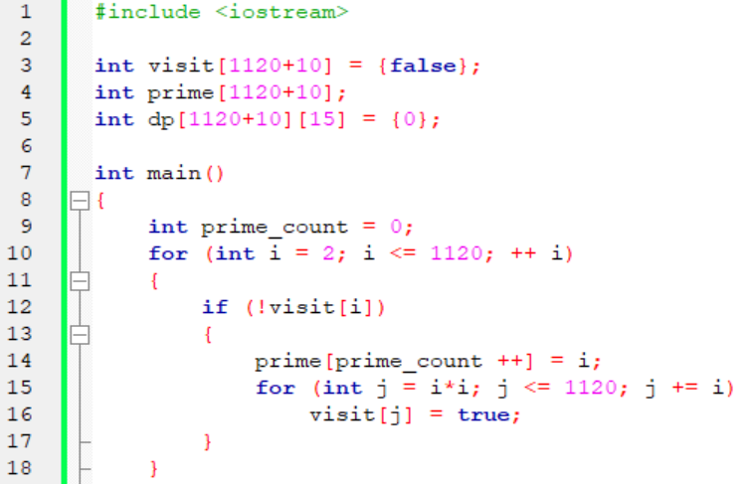

Slide 14
